Slide 1
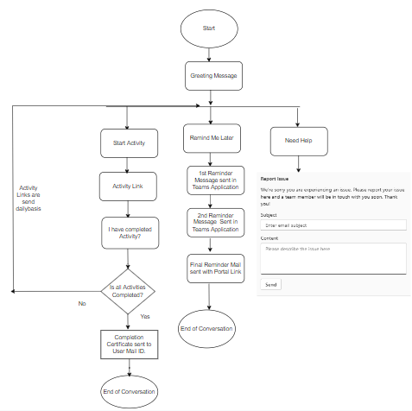
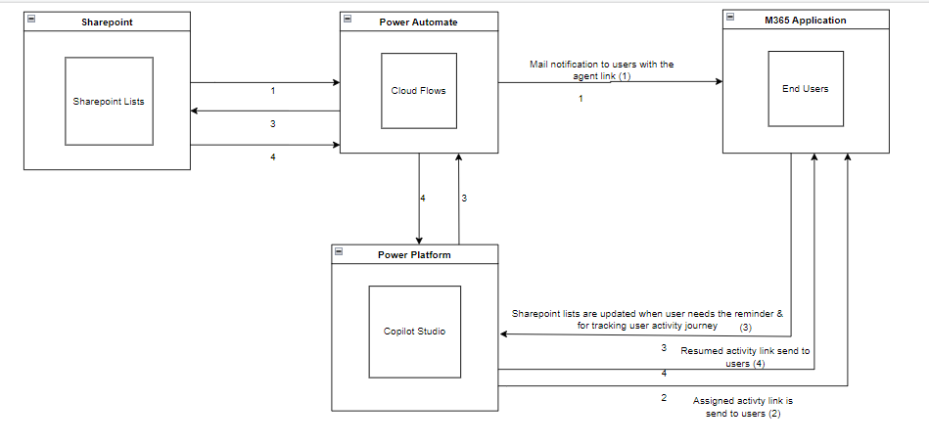
TECH ONBOARDING AGENT
BUSINESS CASE/ OPPORTUNITY
Specific to Global regions of the organization. The use case for this automation is to create a user-friendly agent that navigate users through the onboarding process at the community including tasks and modules they are required to complete.
Created conversational topics to send the assigned activity to the users as soon as their details are updated in sharepoint list. Integrated automated flows to track the progress of the users, sending 3 reminders in 24 hours interval on Business working days, ensuring the engagement in completing daily assigned activity courses and sending automated completion PDF certificate to the respective users . This use case is planned to deploy in M365 tenant – Teams application .
Area
Flow & Architecture Diagram
Business was unable to consolidate and track the training for the list of new joiners , manual follow ups for completion , creating completion certificate which led to more FTE involvement.
Challenge
Solution involves developing a rule-based chatbot with a defined tree structure using Copilot Studio. It assist users by navigating through every day’s activity courses, providing reminders if they don’t complete them, and advancing them to the next stage, also have the process of reporting any technical issues a user may face during the course.
Solution
Personalized onboarding training, task completion tracking, reduced HR follow-up on completion, FTE reduction, Faster turnaround time, friendly agent leading to customer satisfaction.
Benefits

Slide 2
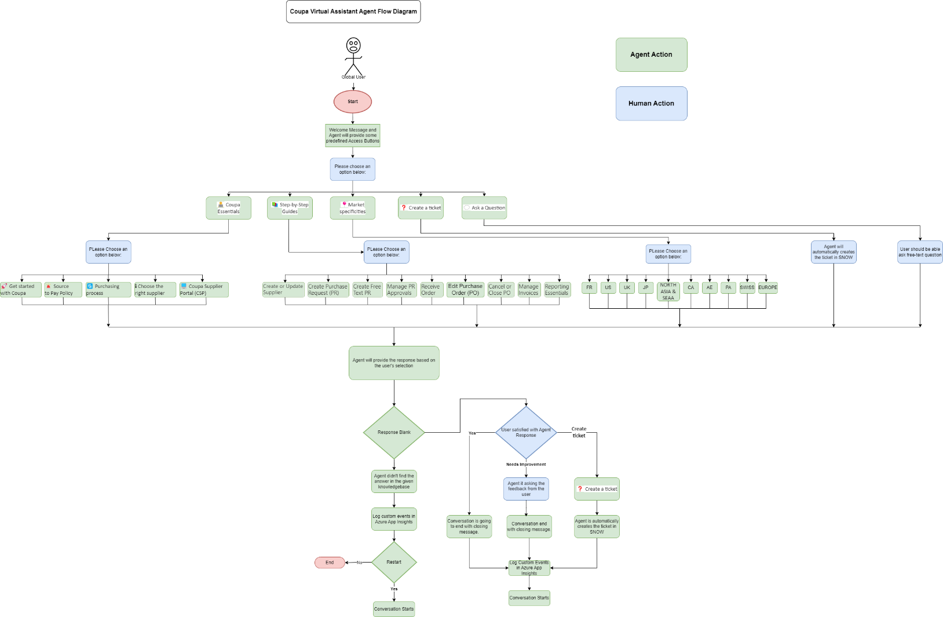
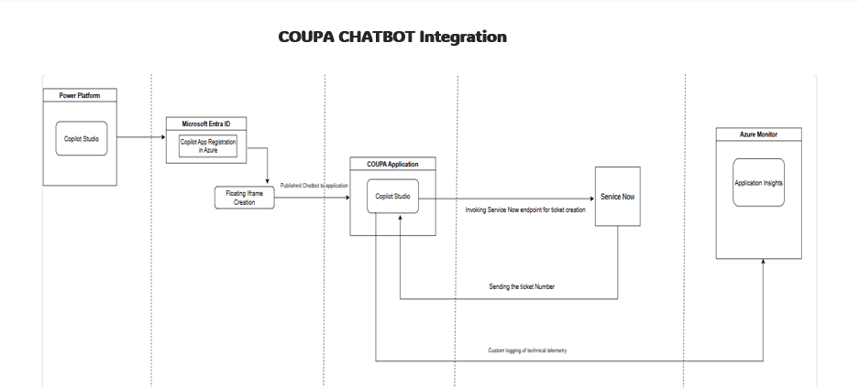
COUPA VIRTUAL ASSISTANT
BUSINESS CASE/ OPPORTUNITY
Designed for global procurement users (10+ markets). Will be deployed on custom SaaS to guide the users in Coupa application about the functionality and features of Coupa and guide them in auto ticket creation in Service Now for any further assistance
Solution leveraged classic orchestration to enable conversation-based topics, providing easy access buttons for quick guide, enabling response to free text queries with the use of knowledge base in Sharepoint, enabled auto ticket creation in Service Now. This chatbot has defined KPI metrics (like Feedback, unknown query) in Azure appinsights, and currently being integrated in BI dashboard for reporting. This use case is planned to be embedded in Coupa web application.
Area
Flow & Architecture Diagram
Business was facing challenges to guide users of all markets separately how to use Coupa leading to multiple FAQs, tedious manual work, more FTE involvement.
Challenge
Solution leveraged multilingual based agent to guide users across all markets. Classic Orchestration enabled the agent to achieve conversational design & gather feedback from users. Offers guided and free-text input. Provides option for auto ticket creation in SNOW via Power Automate. It would be integrated in application enabling multi app registration through IFrames capability.
Solution
Automated support to 10+ markets (2K+ users), reduced manual effort, seamless escalation for assistance in SNOW. Faster turnaround time leading to customer satisfaction
Benefits

Slide 3
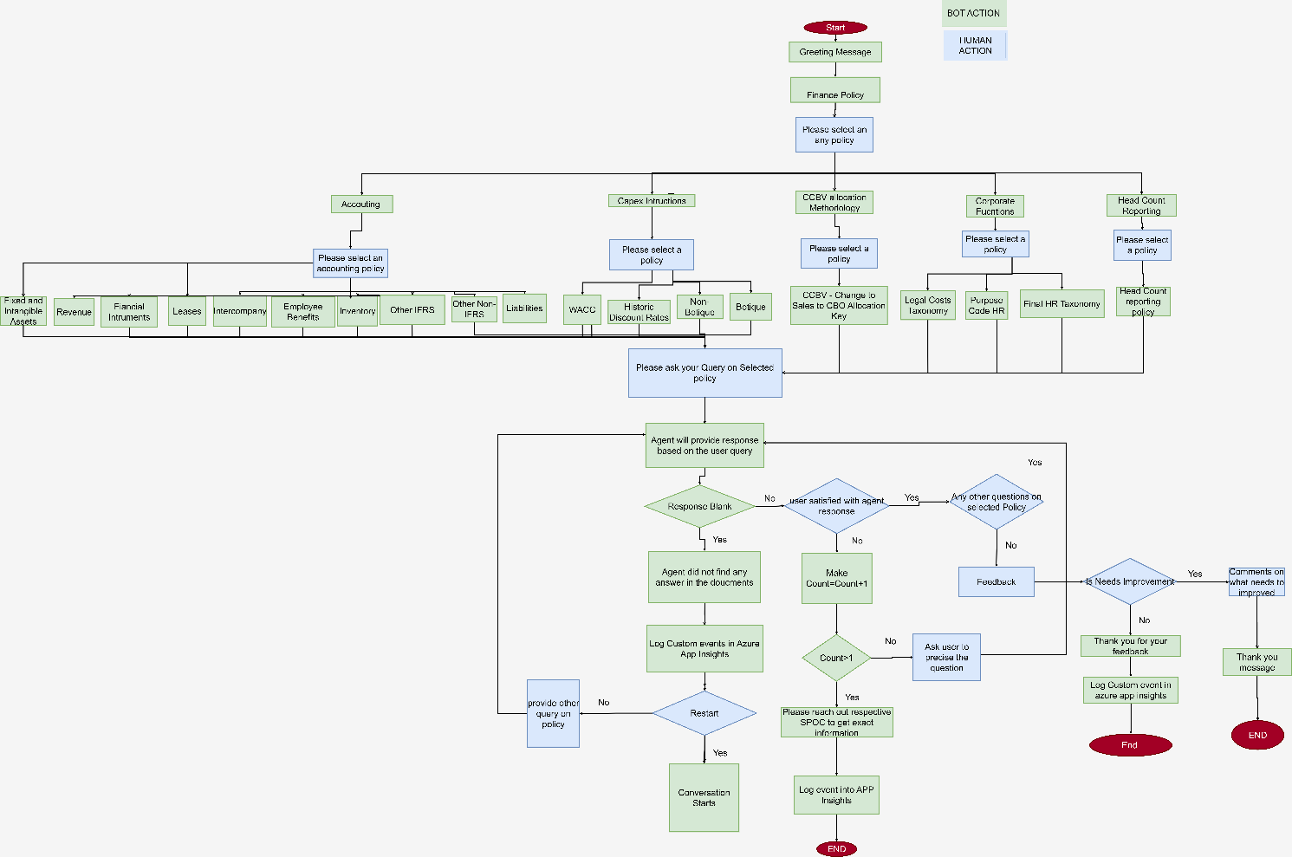
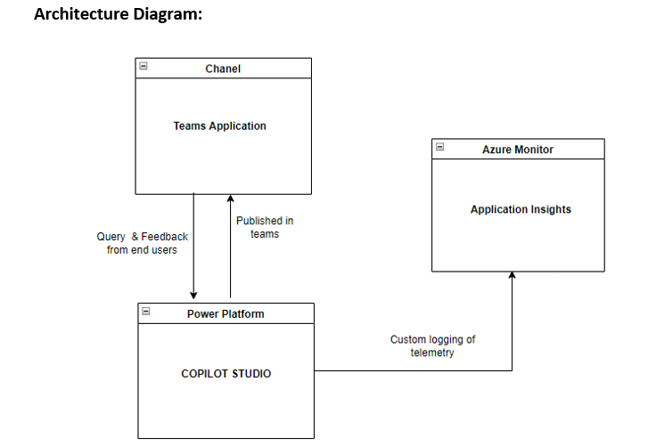
FINANCIAL CHATBOT
BUSINESS CASE/ OPPORTUNITY
Global presence in UK finance sector to address queries on different categories of financial policy documents when a new member joins the finance team
Solution leveraged adaptive cards to offer options to the users to select subcategories of Finance Policy. Agent extracts generative content from mapped documents following the instructions defined in each topic . Feedback mechanism is integrated to capture users real time feedback in Azure which assist management & IT team to improve the efficiency of the agent. This use case is planned to deploy in M365 tenant – Teams application
Area
Flow & Architecture Diagram
Finance Team relied on multiple policy documents to seek clarifications, requiring them to review all documents for answers which consumes time & effort. To streamline this process, the business plans to deploy an intelligent agent that provides quick solutions.
Challenge
Solution involves an intelligent agent using classic orchestration to perform index search in sharepoint based knowledge base . It interacts with users based on their selected policy document and query. If content of the user's query is not available within the selected policy, the agent gracefully notifies . If the agent provides a response that the user finds unsatisfactory, the agent will prompt the user to refine their question for more accurate results. Feedback mechanism integrated to log custom KPI in Azure Appinsights.
Solution
User friendly agent to answer query of the users ,reducing manual effort to search in each category, helping finance team (150+ users) to train the team members.
Benefits

Slide 4
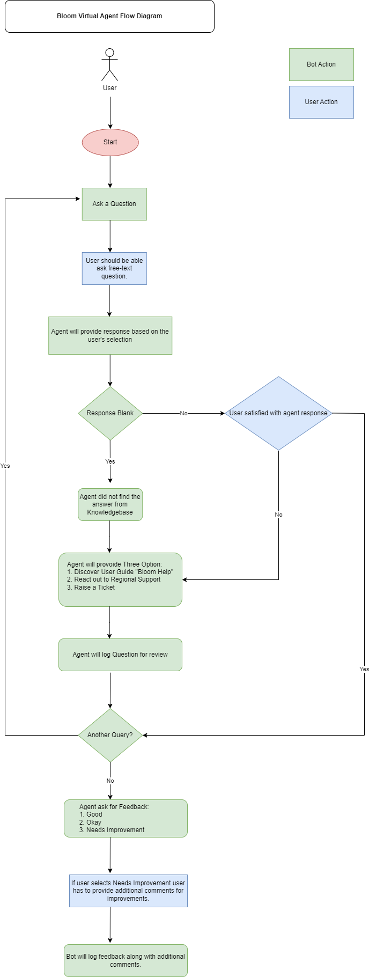
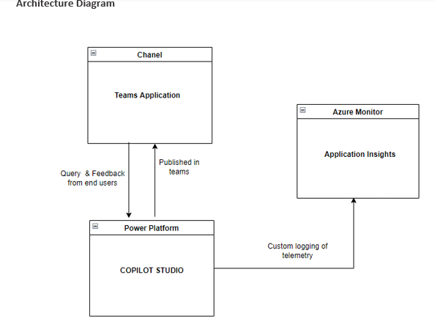
LEARNING & DEVELOPMENT CHATBOT
Global Presence in UK based Learning & Development team to address the queries on process and topics defined in L&D based documentations
BUSINESS CASE/ OPPORTUNITY
Area
Leveraged recently introduced – Generative AI orchestration which enables the agent to perform more accurate search relying on the specific instructions defined , thereby making the design simple and effective. This use case has been deployed in M365 tenant – Teams application.
Flow & Architecture Diagram
Consumed manual effort in understanding specific topics about L&D , insufficient access to proper documentations causing delay and confusion to help and guide them.
Challenge
Solution leverage generative AI orchestration which directly iterate through each documents of knowledge base to provide the accurate response. This do not have control on other topics, so feedback mechanism is handled using trigger functionality of copilot studio to ensure it is captured in Azure app insights
Solution
Helped Learning & Development team to aware team members ( 50+) about different topics on L&D domain and improved engagement. This led to scalable training to the people joining L&D team.
Benefits

